Slide 1


Air Traffic Flow & Capacity Management
Civil Aviation University of China
Civil Aviation University of China

Slide 2
Learning Objectives
Objectives:
State the objectives of ATFM
Describe the main causes of air traffic congestion
Describe the functions of ATFM
Describe the three phases of ATFM
Define the concept of capacity
List the ways to maximize en route capacity
List the methods for the assessment of airspace capacity
List the methods for the assessment of airport capacity
References:
Air Traffic Flow & Capacity Management Strategy
Air traffic Flow and Capacity Management Evolution Plan for the ECAC States

Slide 3
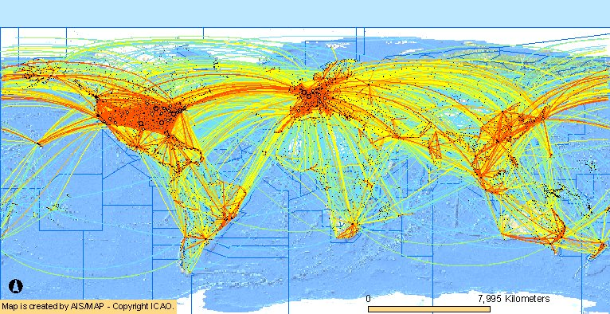
Major World Air Traffic Flows

Slide 4
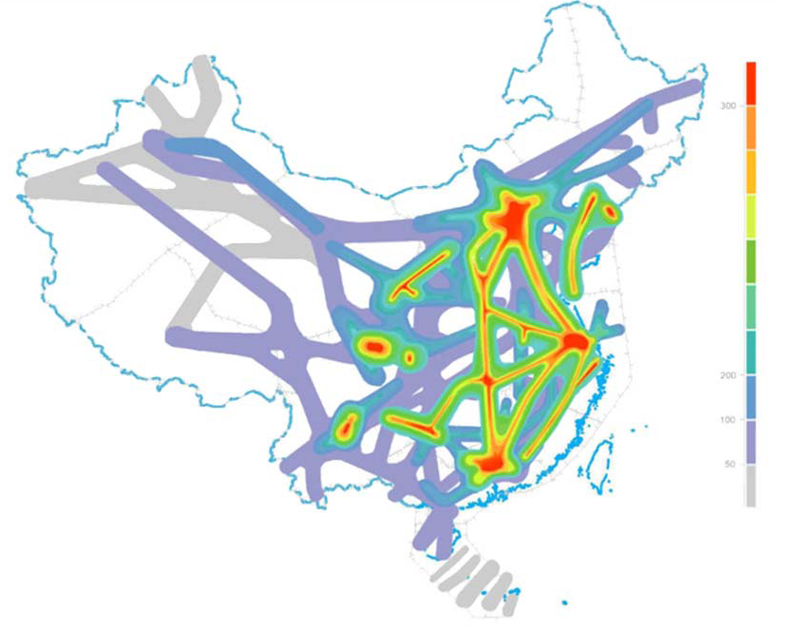
Major Traffic Flows in China

Slide 5
The objective of air traffic flow & Capacity management
To ensure an optimum flow of air traffic to or through areas during times when demand exceeds, or is expected to exceed, available capacity of the air traffic control (ATC) system.

Slide 6
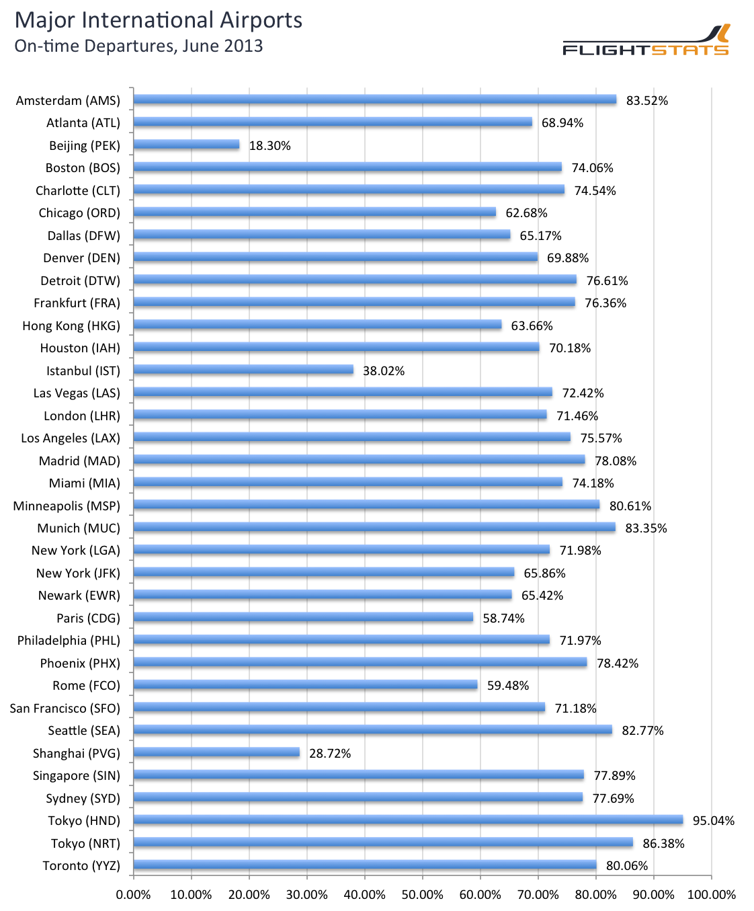
Flight Delays in China

Slide 7
The main causes of the air traffic congestion
accumulation of air traffic during specific periods of the year and also during certain times of the week and hours of the day, due to holiday patterns and travel habits of the public;
differences in the capacities of the various ATC systems or parts of these systems affected by traffic accumulations;
insufficient advance notice (to ATC units) of likely traffic demands which may cause overloading of the system at certain points, in certain areas, and/or during specific time periods;
lack of proven techniques and procedures to restore, in critical situations, a reasonable balance between traffic demand and available ATC capacity by means acceptable to aircraft operators both from an operational and from an economic point of view.

Slide 8
The Consequences of Air Traffic Congestion
An optimum flow of air traffic is not always possible due to various constraining factors, such as conflicting users’ requirements, air navigation system limitations and unexpected weather conditions.
In this connexion, alleviating measures, such as control of air traffic flow, will need to be considered, particularly when the ATC system can no longer fully cope with the volume of air traffic.
Such measures frequently result in delays of flights prior to departure, in-flight holdings, use of uneconomic flight levels, re-routing and diversions, disruptions of flight schedule, economic and fuel penalties for aircraft operators, congestion on aerodromes or in terminal buildings and passenger dissatisfaction.

Slide 9
The functions of ATFCM
collection and collation of data on the air navigation infrastructure and on the capacities of the ATC system and selected aerodromes within the area, including runway, taxiway and gates capacities. This embraces those areas in which traffic flow problems are likely to be encountered;
collection and analysis of data for all planned controlled flight operations into, out of, within and through the area;
determination of a coherent picture of expected traffic demand, including anticipated ad hoc traffic, comparison with available capacity and identification of areas and time periods of expected critical traffic loadings;
co-ordination with the appropriate ATS authorities in order to make every possible attempt to increase the available ATC capacity where required. In some particular situations it could be advantageous for national and local scheduling committees to be established, with representatives from national ATS, airport authorities, national and international operators. Such committees can make significant contributions when developing strategies to reduce the impact of peak demand periods; and where ATC capacity shortfalls cannot be eliminated, determination and implementation in good time of suitable tactical measures coordinated throughout the area as necessary and with aircraft/aerodrome operators concerned.

Slide 10
The functions of ATFCM
Overload !
Initial Demand
Regulated Demand
Capacity
Capacity
Time
Time

Slide 11
Flow management procedures
Strategic Planning
Pre-tactical Planning
Tactical operation
2~6 months ahead
The Previous Day
The Day of Operation

Slide 12
Strategic planning
Strategic planning is be carried out in conjunction with ATC and the aircraft operators. It should consist of examining the demand for the forthcoming season, assessing where and when demand is likely to exceed the available ATC capacity and taking steps to resolve the imbalance by:
arranging with the ATC authority to provide adequate capacity at the required place and time;
re-routing certain traffic flows (traffic orientation);
scheduling or rescheduling flights as appropriate; and
identifying the need for tactical ATFM measures.

Slide 13
Pre-tactical planning
Pre-tactical planning should entail fine-tuning of the strategic plan in the light of updated demand data. During this phase:
certain traffic flows may be re-routed;
off-load routes may be coordinated;
tactical measures will be decided upon; and
details for the ATFM plan for the following day should be published and made available to all concerned.

Slide 14
Tactical operations
Tactical ATFM operations should consist of:
executing the agreed tactical measures in order to provide a reduced and even flow of traffic where demand would otherwise have exceeded capacity;
monitoring the evolution of the air traffic situation to ensure that the ATFM measures applied are having the desired effect and to take or initiate remedial action when long delays are reported, including re-routing of traffic and flight level allocation, in order to utilize the available ATC capacity to the maximum extent.

Slide 15
Possible ATFCM Solutions for Capacity Shortfalls Resolution
CAPACITY | SHORTFALLS | OPTIMISE UTILISATION OF AVAILABLE CAPACITY
 | UTILISE OTHER AVILABLE CAPACITY | Sector Management Configuration Number of sectors Civil/Military Co-ordination Reduce Traffic Complexity Review Capacity Value Holding Pattern Balancing Arrival/Departure Capacity
REGULATE THE DEMAND | Re-routing Flows Flight FL Management Advancing Traffic
Restrictions Acting on Airborne Traffic

Slide 16
The three phases of ATFCM
1 year
1 week
Real-time
Traffic Forecast
Strategic Flow & Capacity Planning
Real-Time Operations
ATC
ASM
Airport
AOs
Establishment of scenarios and harmonized planning considering:
Traffic Demand
Airspace Structure
ATC Capabilities
Airport Capabilities
Optimized Capacity Management
Pro-active optimization of the Network Operations Plan and anticipation of events in order to maintain the network stability
Tactical Flow&
Capacity Management
Monitoring of the ATFCM situation and reaction to real-time events to minimize disruption impact and/or to take benefit of opportunities
Resources
Airspace
ATC
Airport
Feedback
Feedback
Feedback
Feedback
Planning
Execution

Slide 17
Working Process for Strategic ATFCM
CDM
ASM/ATSPs/Airport/AOs/FMD
Consider the following elements
Reduction of Traffic Demand in critical areas
AO Traffic Forecast
Maximize Network Capacity
Re-routing Flows/Flights
Other capacity
Provision of data required to conduct Pre-tactical Activities
(e.g. RAD. Environment Database, Daily Capacity Plans, etc)
Identify the sectors/airports concerned
Airport Capacity
ATM Environment
Pre-validation of scenarios and airspace structure before any publication (AIP, RAD, etc)
ASM
Airspace Structure
(routes, sectors, etc) including capacity values
Holding Patterns
Arr/Dep
Capacity
Define Scenarios/Modus Operandi (routes, areas, sectors)
NO
YES
Pre-tactical & Tactical Working Processes
Are
There Capacity shortfalls?
En-route Capacity
Are
There Capacity shortfalls?
NO
Reduce Traffic Complexity
Increase Capacity Value
FL management
ATC
Capabilities
(Staff resources, operating techniques, system support)
YES
YES
Adapt the Sector Configuration
Acceptable but requiring Pre-tactical and/or Tactical fine-tuning
Airport
Capabilities
(Schedule, infrastructure, etc)
Adapt the Number of Sectors
Civil/Military Coordination
Request for Changes & Feedback
Feedback

Slide 18
Strategic Working Process
Compare traffic demand with strategic ATFCM data
Are
there capacity shortfalls?
No
CDM
Working Process for Pre-tactical ATFCM
Yes
FMD/FMPs
Organization of
ATC behavior
Identify the sectors/airports concerned
Maximize En-route Capacity
Adapt the sector configuration
Maximize airport Capacity
Adapt the number of sectors
Holding Pattern
Arr/Dep
capacity
FMD/ FMPs/ AMCs
Civil/Military Coordination
Reduce traffic complexity
Increase Capacity value
Feedback
Is
Additional capacity?
FMD/FMPs
No
Yes
Are
there capacity shortfalls?
No
Yes
Influence on AOs behavior
Utilize other available capacity
FMD/ FMPs/AMCs
Re-routing flows/flights
FL
Management
Advancing traffic
Yes
Could capacity be maximized?
Yes
Are
there capacity shortfalls?
No
No
Regulate the demand
Apply restrictions
Yes
Could capacity be maximized?
No
Tactical Working Process
Network Operations Plan/Updates

Slide 19
Strategic Working Process
FMD/FMPs/ATC/ AOs/
AMCs
Consider real-time events according to the Network Operations Plan
CDM
Are
there capacity shortfalls or opportunities?
No
No ATFCM action required
Working Process for Tactical ATFCM
Yes
Implement adequate real-time ATFCM solutions
Organization of ATC behavior
Identify the sectors/airports concerned
Feedback
Maximize En-route Capacity
Adapt the sector configuration
Maximize airport Capacity
Adapt the number of sectors
Holding Pattern
Arr/Dep
capacity
Civil/Military Coordination
Reduce traffic complexity
Increase Capacity value
Influence on AOs behavior
Utilize other available capacity
Regulate the demand
Re-routing flows/flights
FL
Management
Advancing traffic
Apply restrictions
Constraining airborne traffic
Provision of a consolidated Network Flow & Capacity Picture for real-time operations
Rea-time Operations (ASM, ATC, Airport, AOs)

Slide 20
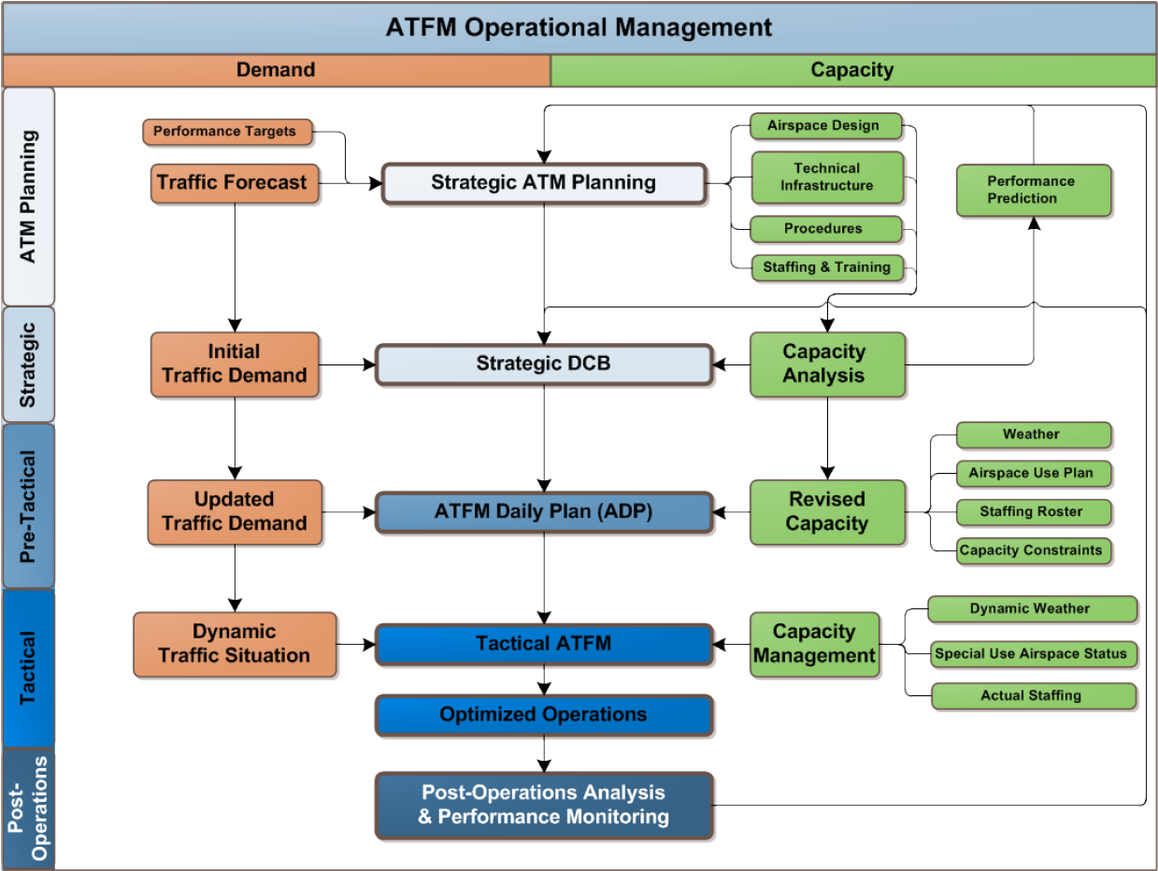

Slide 21
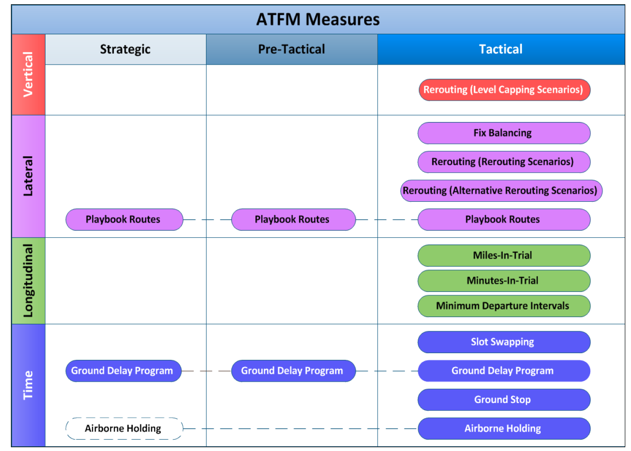

Slide 22
CFMU NETWORK
NETWORK
CFMU
FMP
FMP
FMP
AIRPORT
AIRPORT
AIRPORT
SMALL-SCALE NETWORK

Slide 23
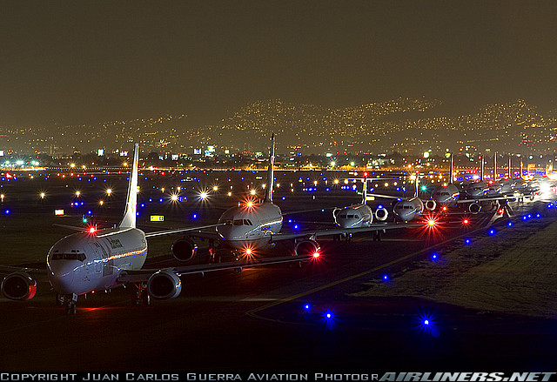
Airport Capacity Assessment
airport capacity is the maximum number of airport operations in a given aerodrome under specified conditions (e.g., aerodrome layout, aircraft mix, weather conditions, facilities, aircraft parking, etc.),
taking into account all
take-off and landing
operations during a
specified period of time
(hour, day, month,
year, season).

Slide 24
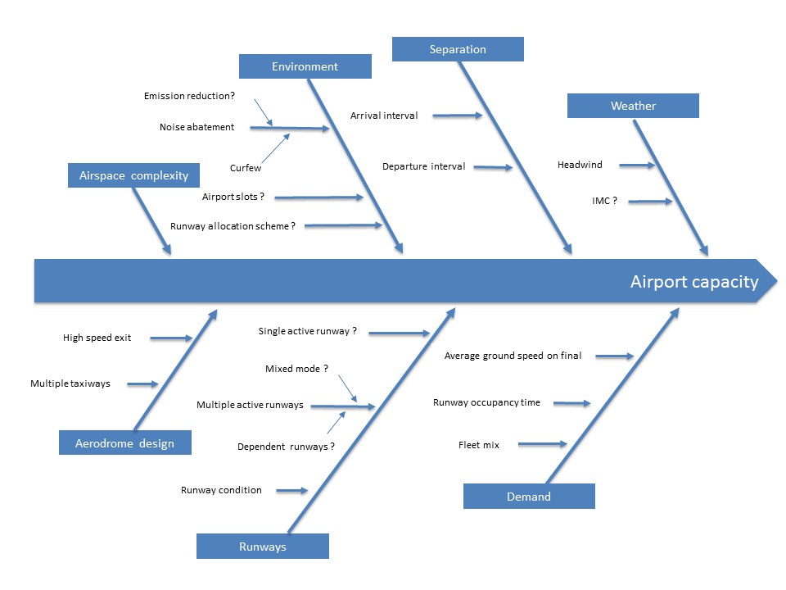
Factors Impacting Airport Capacity

Slide 25
Methodologies to Assess Airport Capacity
Analytic models
Time-space analysis
Queuing models (deterministic and stochastic)
Simulation-based models
Monte Carlo Simulation
Continuous simulation models
Discrete-event simulation models

Slide 26
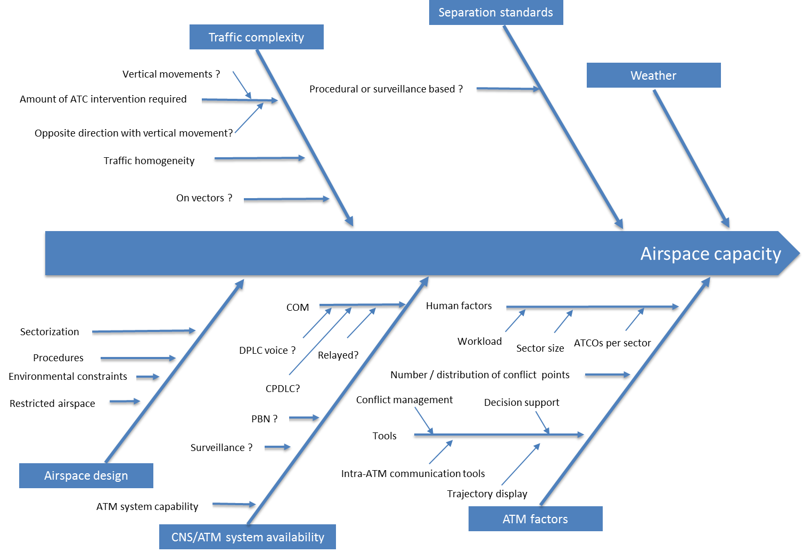
Factors Impacting Airspace Capacity

Slide 27
Methodologies to Assess Sector Capacity
Sector capacity is restricted by the controller workload
Methods:
“DORATASK” method
MBB Method
The essence of both methods was to measure the necessary time for all control working actions and to relate this time to the total time available.
The average workload at capacity must be less than 80% and workloads of 90% must not be exceeded more than 2.5% of the time

Slide 28
Controller Task load
Observable tasks
radiotelephony (RTF) and telephone communication,
strip marking
direct-voice-liaison coordination.
Inputs, etc.
Non-observable tasks
Monitoring the radar screen
Planning future actions
Recuperation
Notes:
Recuperation: To return to health or strength; recover.

Slide 29
Questions
What are the objectives of ATFM?
What are the main causes of air traffic congestion ?
What are the functions of ATFM ?
What are the three phases of ATFM ?
What is the concept of capacity ?
What are the ways to maximize en route capacity ?
What are the methods for the assessment of airspace capacity ?
What are the methods for the assessment of airport capacity ?

